Slide 1
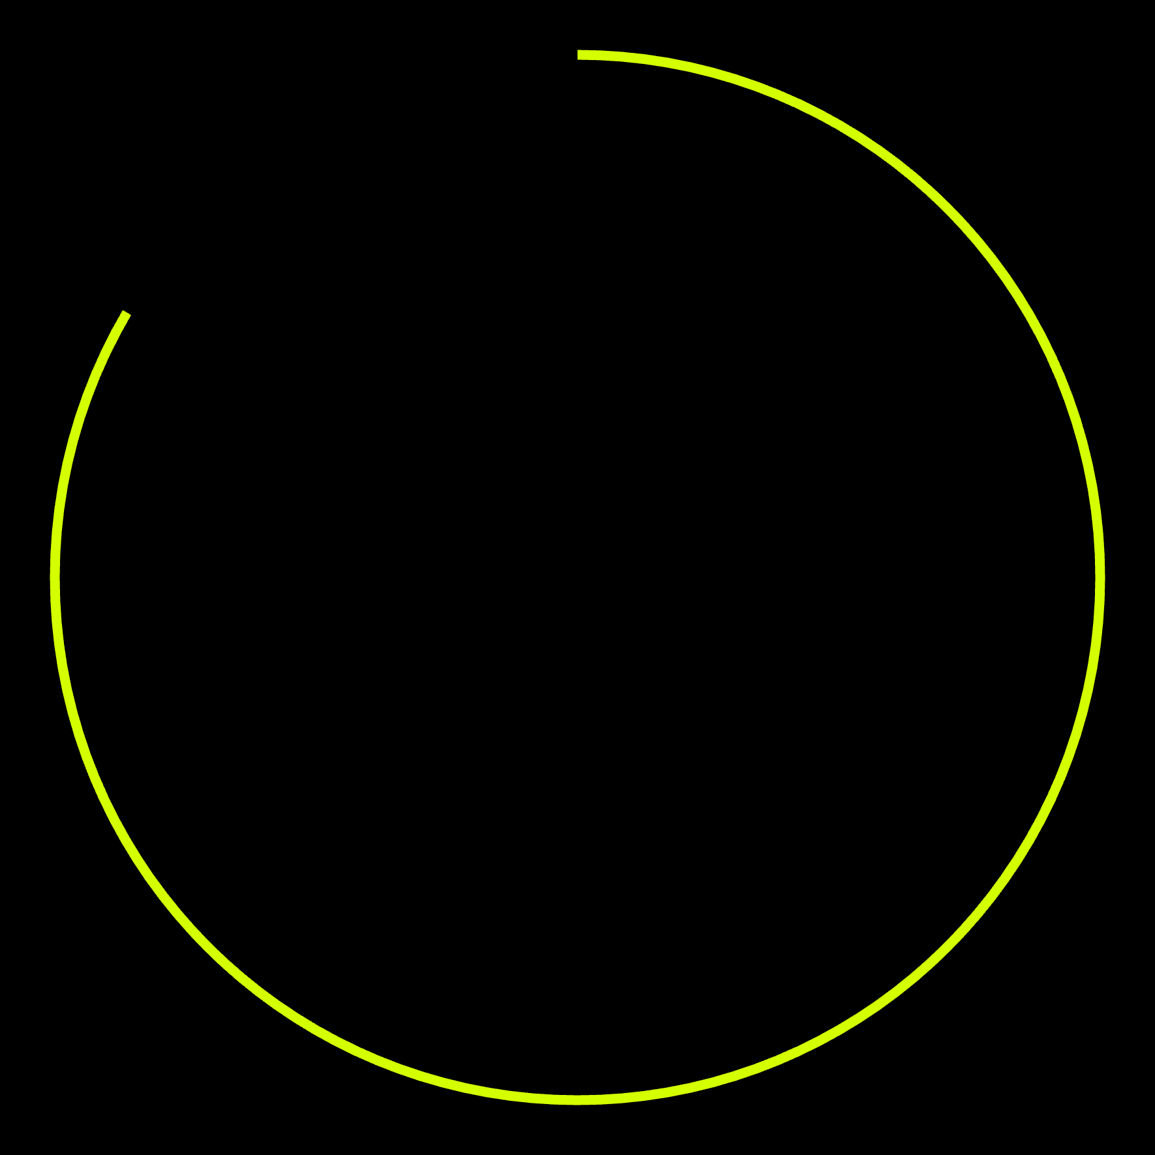
●
● DESIGN RESOURCES
MAKE / BUILD
08
Build with Codex
Better design.
8 open-source building blocks
Components. Color. Type. Diagrams.
Pick what fits
UI
Color
Type
Diagrams
Choose a resource. See the effect. Build.
VISUAL / 01

Slide 2
●
02
● THE DESIGN MAP
Give every resource a job
01
Interface
shadcn/ui
↗
02
Color & type
Radix Colors / Fontsource
↗
03
Diagrams
Mermaid / Rough.js
↗
04
Project pages
Simple Icons / README Stats / Markdown Badges
↗
Components, packages and assets have different setup steps.

Slide 3
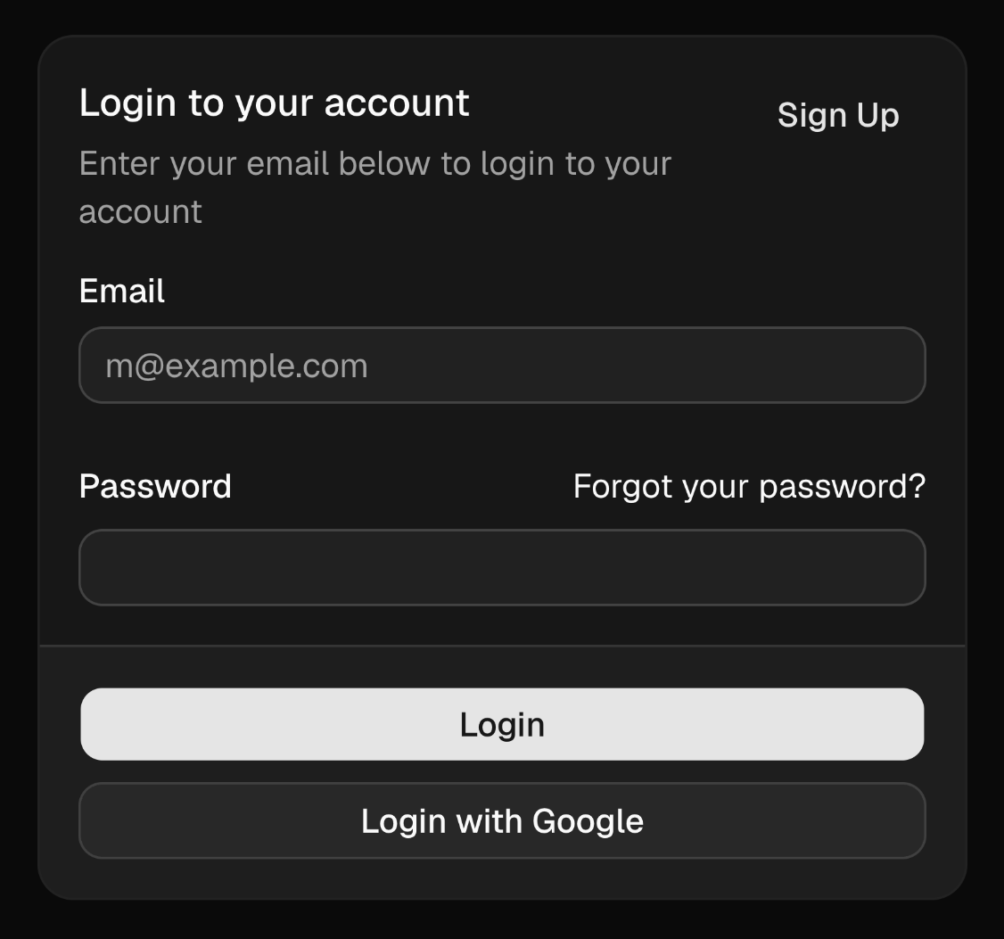
●
03
● shadcn/ui
Start with a component
Buttons. Forms. Dialogs.
OFFICIAL / CARD
Pick an example. Make it fit.
01Component structure
02Typography & color
03Spacing & layout
Explore official components
↗
Official component screenshot · Sep 2026
Official example — not a claim of integration into a live project.

Slide 4
●
04
● Radix Colors + Fontsource
Same layout. Different feel.
●
● OFFICIAL SAGE SCALE
MY PROJECTS
↗
1
2
3
4
5
6
FONT & COLOR
#fbfdfc
#f7f9f8
#eef1f0
#e6e9e8
#dfe2e0
#d7dad9
My projects
7
8
9
10
11
12
Components, color and type
shape the feel of a page.
#cbcfcd
#b8bcba
#868e8b
#7c8481
#5f6563
#1a211e
One scale for surfaces, borders and text.
Surface
Border
Text
Sage palette
Electric blue
View projects →
Sans serif
Serif
A sample interface with coordinated color and typography.
Layout demo. Fonts embedded via Google Fonts; Fontsource is a resource to explore.

Slide 5
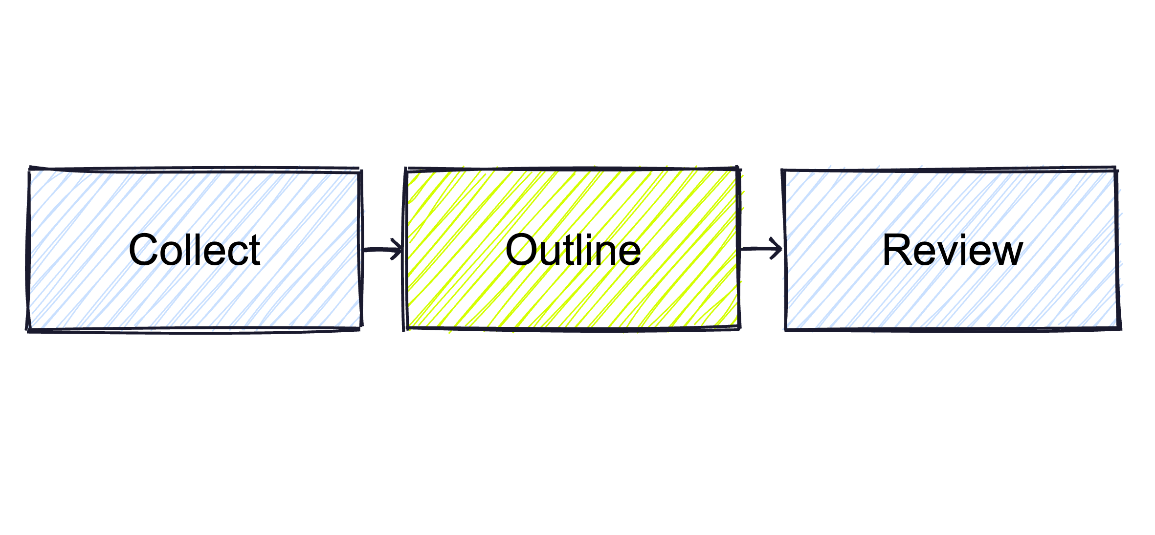
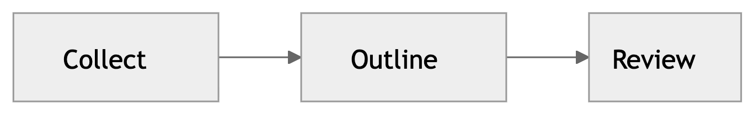


●
05
● Mermaid + Rough.js
Flowchart or hand-drawn?
●
● Mermaid
●
● Rough.js
Turn text into a diagram
Draw sketch-style shapes
flowchart LR
A[Collect] --> B[Outline] --> C[Review]
Rendered from text. Follow the nodes and links.
Sketch-style shapes positioned in code.
Mermaid repository↗
Rough.js repository↗
Demonstration only — not an automatic layout or design benchmark.

Slide 6
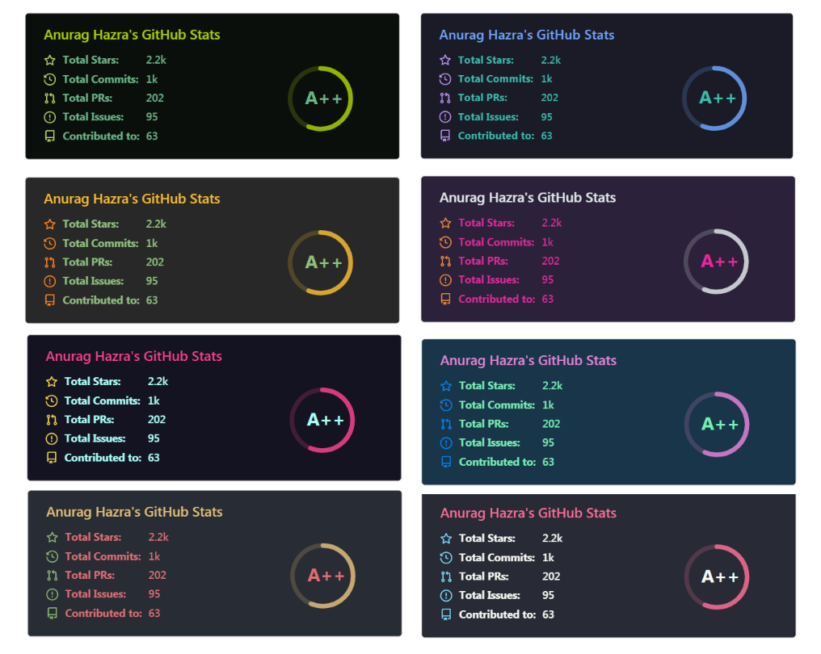



●
06
● Simple Icons + README Stats + Markdown Badges
Polish your project page
●
GITHUB README STATS
● Simple Icons
Brand SVG icons
Choose the brands your project uses.
Browse brand icons↗
●
● Markdown Badges
Badges with ready-to-use code
![Label](badge-image-url)
Official themes · example account data
Browse badges & code↗
See configuration options↗
Stats and badges are for GitHub project pages. Shown data is from an official example.

Slide 7
●
07
● PUT IT IN CONTEXT
Start small. Make it fit.
01
02
Product interface
GitHub README
Components, colors and fonts
Icons, stats cards and badges
# My Project
Project introduction
![Stats](stats-image-url)
Explore full UI examples
↗
Explore README examples
↗
Usage examples. Buttons open official demos, not a product built in this video.

Slide 8
●
08
● 8 OFFICIAL REPOSITORIES
Save these building blocks
shadcn/ui
↗
Radix Colors
↗
01
Components & setup
02
Color scales & usage
shadcn-ui
radix-ui
Fontsource
↗
Mermaid
↗
03
Fonts, weights & coverage
04
Diagram syntax & rendering
fontsource
mermaid-js
Rough.js
↗
Simple Icons
↗
05
Canvas / SVG examples
06
SVG files & packages
rough-stuff
simple-icons
README Stats
↗
Markdown Badges
↗
07
Card setup & deployment
08
Copy the Markdown
anuraghazra
Ileriayo
Browse an example, then follow the setup for your project.

